Slide 1
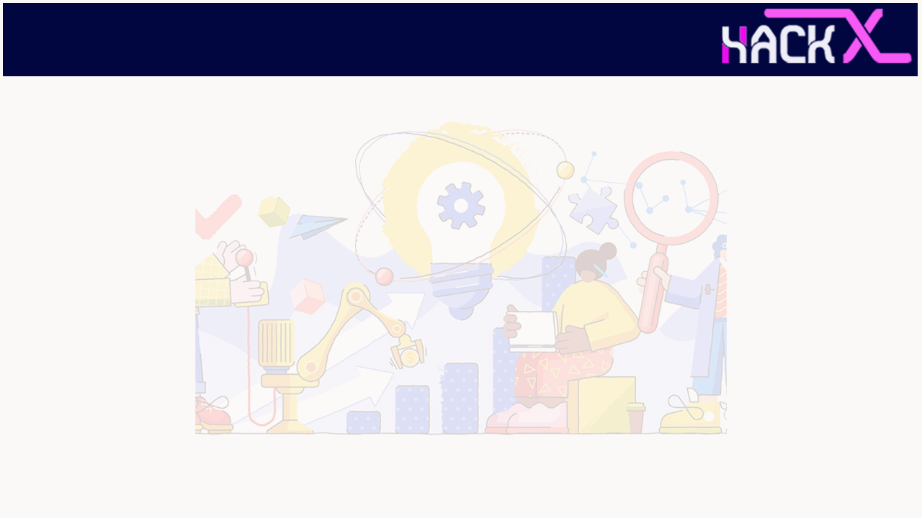
Team Name :Runtime Terror
Members Name and Phone Numbers 1.Brahmjot Kaur,9914593424(Leader)
2.Arjun Pundir ,7357794481
Domain name: Wearable Technology
Problem statement :Problem faced by coders in covid time

Slide 2
ABSTRACT
Video conferencing plays extremely important role in communication today which can be point-to-point or multipoint real-time communication between two or more student located at different geographical locations. However, it is very difficult to code in teams, especially in distance education classroom. Also in distance education, there is requirement of real-time interaction between faculty and student, getting feedback of student's reactions at remote class to a lecture is very important. However, there is some delay between camera control operations at a remote classroom and actual video image displayed on a local screen. These delays are due to network delay between sender and receiver and due to video compression. To operate remote camera interactively, user must consider these delays while controlling these device. This presentation proposes a system for creating a code IDE with video conferencing where all people can connect and code on one platform. To make things more easier for coders in covid time ,this project will aid them to work more efficiently.

Slide 3
NOVELTY
Live Coding : A coding IDE where all the people connected to a room can code simultaneously.
Code Execution with syntax highlighting : Allows you to choose from a couple of languages and compilers, and highlights syntax on the basis of them. You can also supply input, run the code and get
output.
Live Whiteboard : The interface also consists of a whiteboard which all the members in the room can use to draw stuff. The whiteboard also contains multiple features like colorful pens, pens of different sizes etc.
Screen Sharing Feature : The webApp also allows you to share screen during the video call.
Normal Chat Feature : There is also a chat feature which allows you to send text messages to each other.

Slide 4
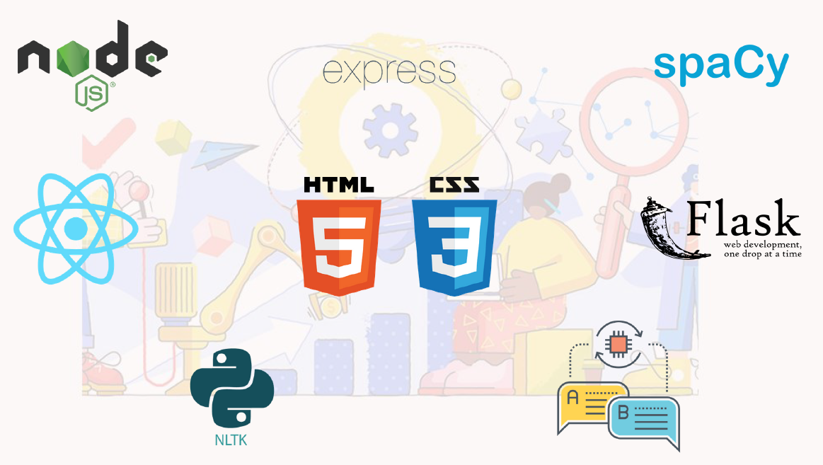

TECHNOLOGY STACK

Slide 5
BUSINESS SCOPE
Collaborative Work: If a group of people is working on some project then they can easily sit together and debug the errors. It will be easy for everyone. And Hence new, effective and innovative ideas and projects will come in market making the life people easy.
Enable the Digital Workforce: Video conferencing software not only creates a more collaborative meeting culture in your organization, it’s a foundation for enabling today’s digital workforce.
3. Simplify Management and Usability: By deploying a consolidated online meeting solution with a simple UI that is c centrally managed, teams can focus on their meetings instead of being burdened with troubleshooting every meeting.

Slide 6
THANK YOU

